Slide 1
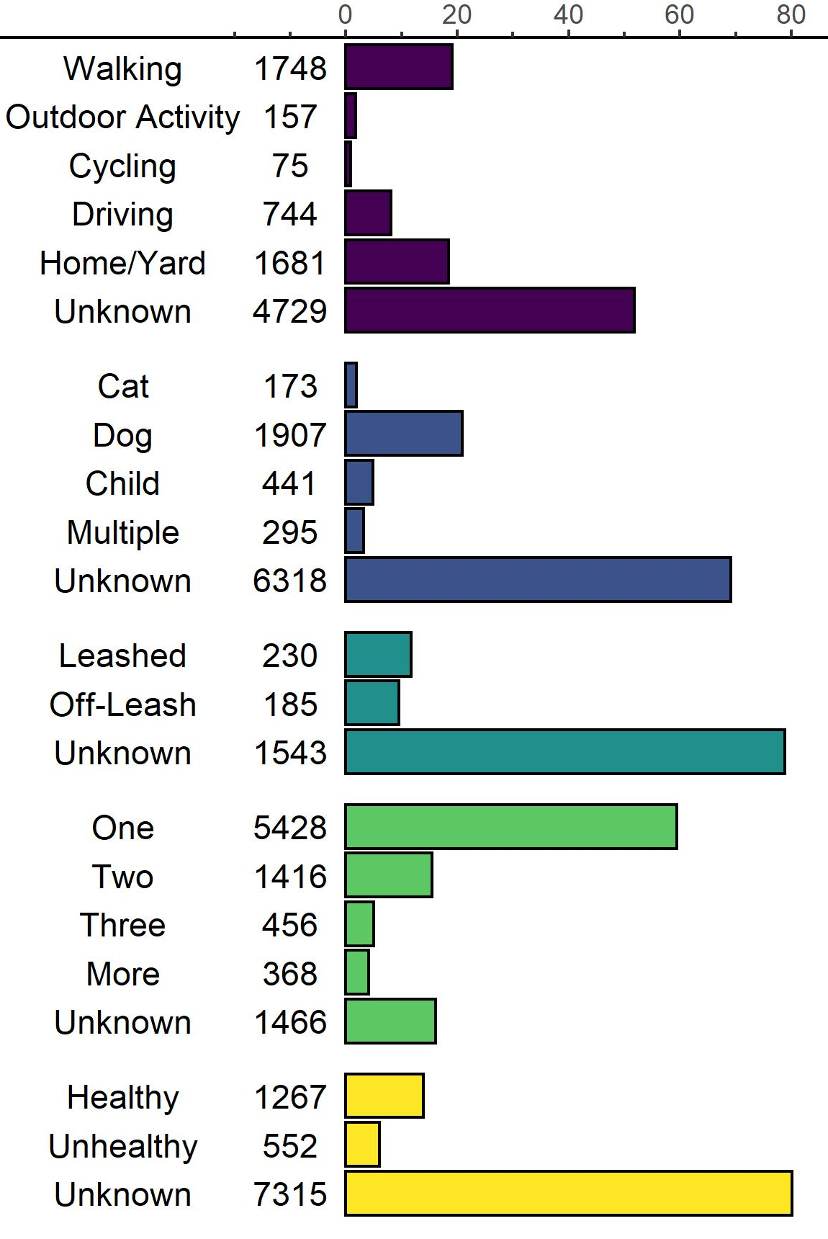
Variable | Categories | N | Percentage (within category)
Human Activity
Vulnerable Individuals
Dog Leash Status
Number
of Coyotes
Coyote Health

